Slide 1




Pasos Para Prevenir Cancer:
Understanding the nutrition labels
Notes:
Hello and Welcome back to Pasos Para Prevenir Cancer! Once again, my name is Roy and this week we will be discussing Nutrition Facts Labels. If you recall from last week, we went over strategies that we can implement into our daily routines to make eating, healthier. Now we will further improve healthy choices by showing you ways to pick healthier products over less healthy products. Nutrition facts labels tell us about a products serving size, number of servings in the package, calories per serving and the amount of various nutrients contained in the product. Once you understand the labels, they can help you follow a healthy diet and make it easier to choose the most nutritious foods. In the next slide, we will break down the label into several sections and explain each one.

Slide 2
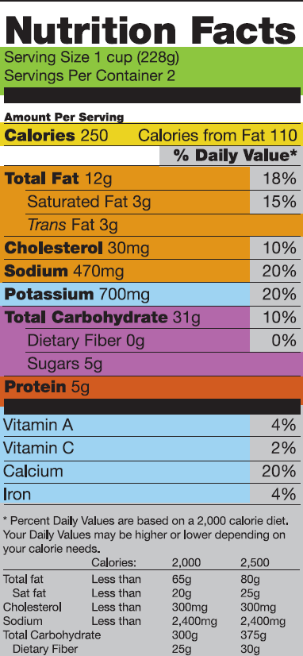
The Nutrition Facts Label information is based on ONE serving, but many packages contain more. Look at the serving size and how many servings you are actually consuming. If you double the servings you eat, you double the calories and nutrients, including the % DVs.
This is where you’ll find the number of calories per serving and the calories from fat in each serving.
To help reduce your risk of heart disease, use the
label to select foods that are lowest in saturated fat,
trans fat and cholesterol.
When choosing a food for its protein content, such as
meat, poultry, dry beans, milk and milk products, make choices that are lean, low-fat, or fat free.
Fiber and sugars are types of carbohydrates. Healthy
sources, like fruits, vegetables, beans, and whole grains,
can reduce the risk of heart disease and improve
digestive functioning.
The % DV is a general guide to help you link nutrients in
a serving of food to their contribution to your total daily
diet. It can help you determine if a food is high or low in a
nutrient—5% or less is low, 20% or more is high.
Use the label not only to limit fat and sodium, but
also to increase nutrients that promote good health
and may protect you from disease.
Notes:
The diagram provided breaks down the nutrition facts label into seven different categories. For visual purposes I will describe each section based on color. The green portion of the label describes the serving size and number of servings per container. This portion is very important because it can be very misleading. The information on the nutrition facts label is based on only ONE serving, however, many package contain more than one serving. Therefore it is important to know how many serving are in a container or package. For instance, the contents in this package are measured in 1 cup, however this package contains two servings. So there are two cups worth of product in this container. If you double the servings you eat, you double the calories and nutrients, including the percent daily values, which we will go over shortly. Next we will go over everyone’s favorite topic, CALORIES! The yellow section displays the Calories per serving and is broken down into two areas. The number of calories in the container and the amount of calories from fat in the container. It is very important that we understand that a calorie is simply a unit of energy and it refers to the energy people get from the food and drinks they consume, and the energy they use in physical activity. The orange section shows the information that is important for reducing your risk of heart disease. It shows the percent daily values of total fat, which includes saturated and Trans fat, cholesterol, and sodium. Remember, every content on this label will be duplicated because there are two servings in this container. Next we will look at the purple section. This section shows the total carbohydrate content, including dietary fiber and sugars in the container. Healthy sources of carbohydrates like fruits, vegetables, beans, and whole grains, can reduce the risk of heart disease and improve digestive function. The orange section shows the amount of protein that this contain has. It is displayed in grams. The light blue section is split into two key areas, Potassium on top and then vitamins A and C, Calcium, and iron at the lower end. These are key nutrients that promote good health and may protect you from disease. The gray area indicates the percent daily values based on a 2,000 and 2,500 calorie diet. The % DV is a general guide to help you link nutrients in a serving of food to their contribution to your total daily diet. It can help you determine if a food is high or low in a nutrient—5% or less is low, 20% or more is high. Now that we know some key information found in the nutrition fact label, lest go over some commonly used products in the following slides.

Slide 3
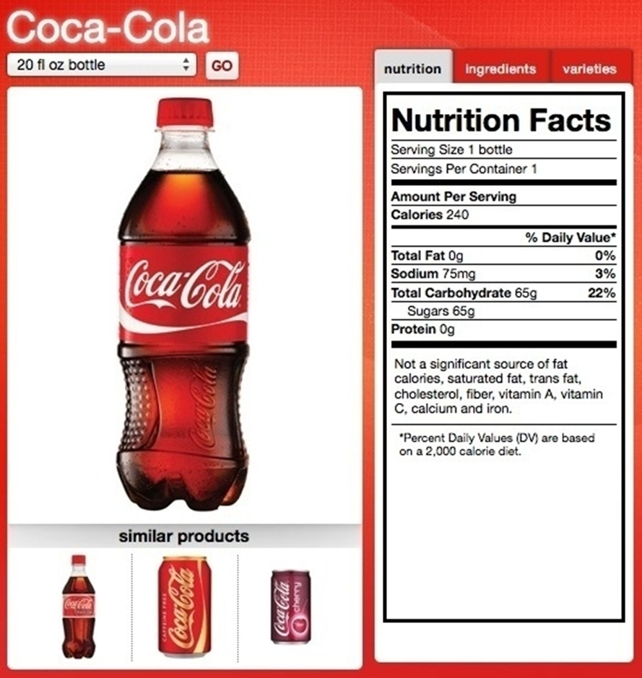

Notes:
This slides shows one of the most common drinks that should be limited or avoided all together, soda. In this picture we have a 20 fluid ounce bottle of cola. The serving size of this product is one bottle and it only contains one serving. It contains 240 calories and zero grams of total fat. It also has 75 milligrams of sodium, which equals only 3 percent of the percentage daily value that we are recommended. The total carbohydrates in this bottle are 65 grams or 22% of the percentage daily value recommended. It is important to note that those 65 grams come in the form of sugar. This product also contains zero protein. As we can see from the note below the protein, this product is not a significant source of fat calories, saturated fat, trans fat, cholesterol, fiber, Vitamin A, Vitamin C, Calcium or Iron. The next slide will focus on those 65 grams of sugar in this product that we mentioned earlier.

Slide 4
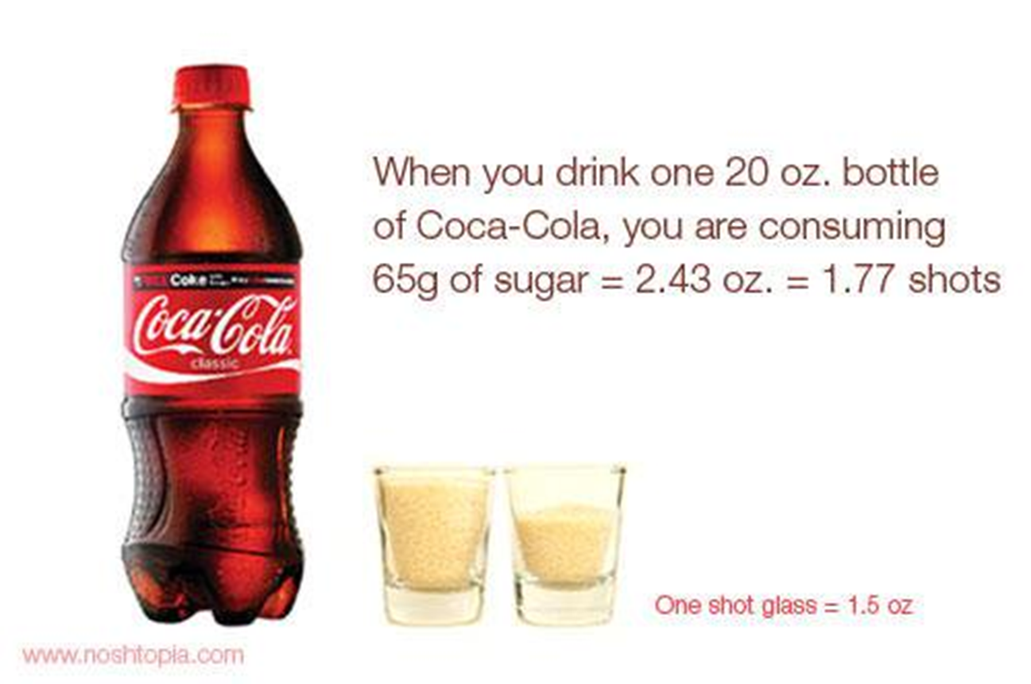
Notes:
As we just mentioned, when you drink one 20 ounce bottle of a cola, you are consuming 65 grams of sugar. This equates to 2.43 ounces or 1.77 shots of sugar. The volume alone doesn’t describe the high content of sugar. Think about people who drink more than one bottle a day routinely. I would like for you all to keep note of the nutrition fact label for this cola as we move on to other foods that we normally eat. I really want to emphasize that one soda alone contains almost a quarter of the total carbohydrates that someone should consume in one day based on a 2,000 calorie diet. It is easy to tell you not to drink or eat something, but that would make our education less effective. To enhance our educational session, we will also make recommendation for alternatives that can replace drinks and common meals. The next slide will go over healthier drink options.

Slide 5
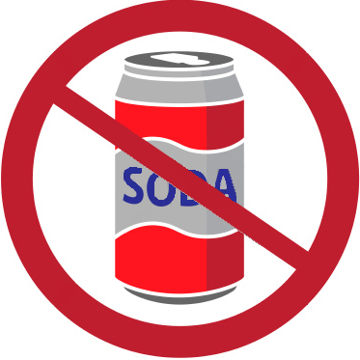
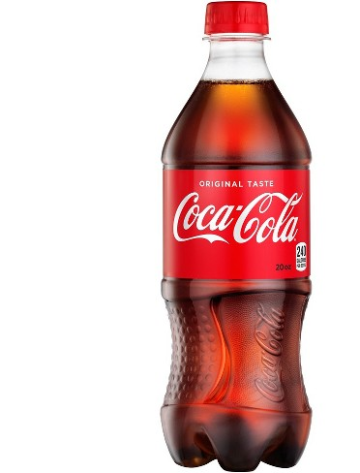

Soda Alternatives.
Unsweetened Teas
Sparkling water
Natural fruit juices
Herbal teas
WATER!
Notes:
Some healthier alternatives to any type of soda are unsweetened teas, sparkling water, natural fruit juices, herbal teas, and of course water. Plain water is still the healthiest thing we can drink. If plain water is simply too boring for you, you can always add items like crushed fresh mint, citrus fruit zest, peeled, sliced ginger or sliced cucumber, and of course fresh lemons or lime. The key is to stay away from those added sugars we discussed last week. This is why we emphasize the use of unsweetened teas, sparkling water, and herbal teas as an alternative to drinking soda. In a later slide we discuss the difference between 100% pure fruit juice and one that is not, therefore I will not speak of this topic much in this slide. However, it is important to know that there are different levels to juices. For instance, Sunny Delight, only offers 13 % fruit juice from concentrate where others offer 100% fruit juice. There is one thing to be cautious about though, remember that fruits are still a natural way of consuming carbohydrates, or sugars as we usually call them. Remember last week when we mentioned that one of the goals of Choose MyPlate was to reduce sodium intake? Well on the next slide we will go over the importance of understanding sodium on a food label.

Slide 6
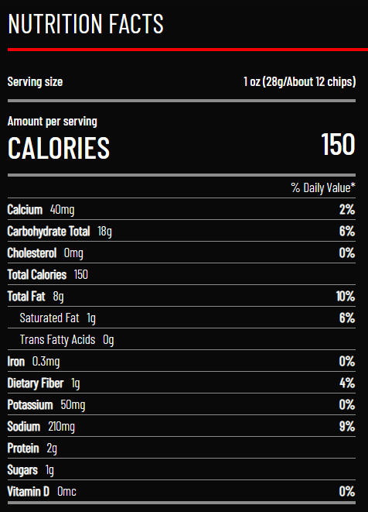
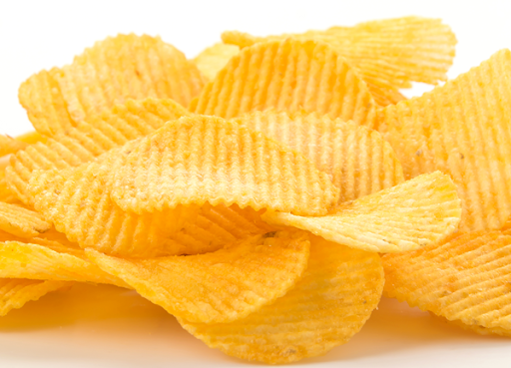
Sodium Case Example.
Servings per bag= 9
Notes:
The next culprit in our discussion about nutrition fact labels is the infamous potato chips. Before we get to the sodium content for this bag of chips, let’s break down the rest of the label. First of all, the serving size for this bag is one ounce, or about 12 potato chips. Each serving size, or every 12 chips contains about 150 calories, 40 milligrams of calcium, a carbohydrate total of 18 grams, 1 gram of saturated fat, which seems like a little bit, however, it equates to 6 percent of the percentage daily value. Once again, remember this is for only 12 chips. The sodium content in this bag is 210 milligrams or 9 percent of the percentage daily value. This is where serving size and servings per container come into play. This bag of chips contains 210 mg of sodium in every 12 chips. Let’s assume this bag meets the average bag studies which is about 9 servings in a bag. When you multiply 210mg by 9 servings you come up with 1,890mg of sodium in one bag. If you think back to the Choose MyPlate class, the USDA has reduced the recommended daily intake of sodium to 1,500 mg per day as opposed to 2,300. Think about this slide the next time you down a bag of chips watching your favorite movie or sports team play. Next we will discuss how the World Health Organization views salt.

Slide 7
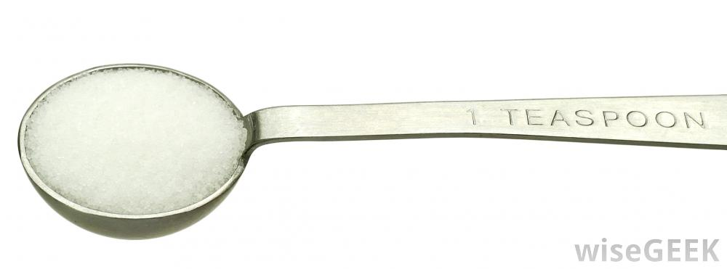
Salt
For adults: WHO recommends that adults consume less than 5 g (just under a teaspoon) of salt per day.
Notes:
Salt is an ingredient that has been targeted by health organizations like the WHO for many years now. The reason for the attack on salt is that salt is associated with higher blood pressure and 50 to 70 million people in the U.S. have hypertension. All these people would benefit from a low-salt diet like the Dietary Approaches to Stop Hypertension, better known as the DASH diet. The DASH diet is a very healthy, low-sodium diet, which has a lot of vegetables and not a lot of salt. The WHO has equated that on average a bag of chips contains about 1890 mg of sodium which then equates to roughly 4.72 grams of salt, or one teaspoon of salt. They recommend that adults consume less than 5 grams of salt per day. This may seem impossible, so on the next slide we are going to make some comparisons of everyday foods and their sodium content to help us decide which items we should be eating and which ones we should avoid.

Slide 8
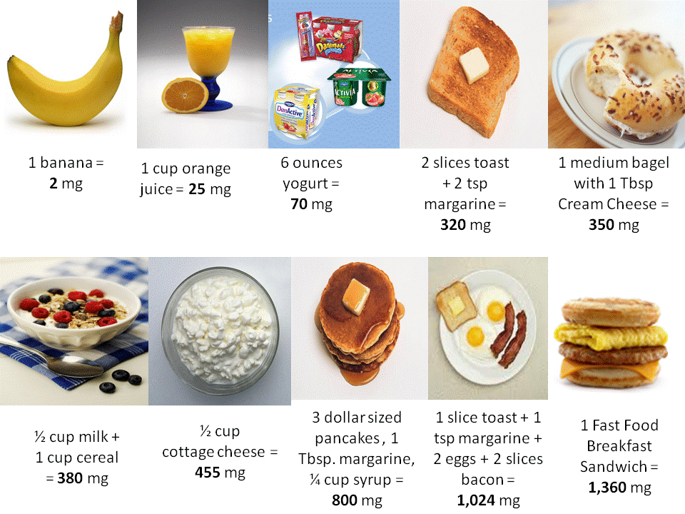
Notes:
As you can see from the slide, we will be discussing ten different breakfast options and their sodium content. As I mentioned a few times earlier, the USDA recommends that we consume no more than 1500 milligrams of sodium per day. We will be using that as our benchmark to creating a healthy meal. As you can see, the pictures are placed from the least amount of sodium to the most. Think about your normal breakfast when going along and start thinking about ways you can improve your morning by eating a healthier breakfast. For starters that fast food breakfast sandwich is almost 1500 milligrams. It is safe to say that if you get the meal which includes a hash brown and a drink, you will easily surpass the recommended daily intake, and its only breakfast time. In creating a meal that will fill you up, can you believe that one banana, one cup of orange juice, a 6 ounce container of yogurt, 2 slices of toast w 2 teaspoons of margarine, 1 medium bagel with 1 tablespoon of cream cheese, and a cup of cereal with ½ cup of milk is only 1,147 milligrams of sodium? If you would like more of a traditional breakfast, 1 slice of toast with one teaspoon of margarine, 2 eggs and 2 slices of bacon, plus a cup of orange juice and a banana equals only 1,278 milligrams of sodium. While not a recommended way to consume sodium this early in the day, it still contains less sodium and is more filling than the fast food breakfast sandwich. If I had to choose between these items, my go to meal would consist of the cereal (380mg) banana (2 mg) and the Orange Juice (25 mg). Therefore I still have about two thirds of the recommended daily intake of sodium to go. I understand that the borderland has its own unique food culture. So in the next few slides we will compare and contrast common foods that are included in our everyday foods here in El Paso.

Slide 9
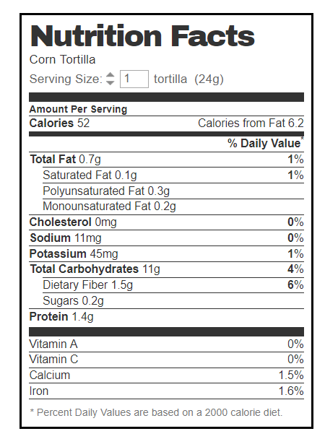
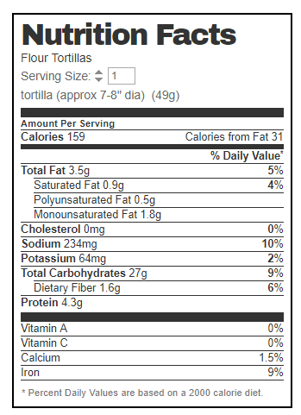
Corn Tortilla vs. Flour Tortilla
Notes:
As we already know, the tortilla is a staple of the Mexican diet and a huge element of Mexican cuisine in the United States. In this slide we will compare the nutrition fact labels for both a corn tortilla and a flour tortilla. But first let’s discuss how they are normally made. Corn tortillas are made from a simple mixture of a finely ground corn flour and water. Similarly, flour tortillas are made from wheat flour and water. Sometimes tortilla recipes call for salt and leavening agents, especially for flour tortillas. The mixture is portioned into balls, pressed into a flat patty and then toasted to perfection. One thing we do have to be mindful of when it comes to both types of tortillas is that home-made tortillas and large-scale production tortillas are not the same. Large-scale tortillas often have preservatives that are needed to keep the tortillas fresh until they're sold to the consumer. Later we will discuss some dishes that use tortillas, but first off, let’s compare them. In comparing the labels, we can see that the corn tortilla is obviously smaller, since a serving size is only 24 grams and the flour tortilla is 49 grams. The calorie count is proportional to the size because the corn tortilla, which is smaller, contains only 52 calories, while the larger flour tortilla has three time the amount at 159 calories. Based on the remainder of the food label, it is evident from the label that the corn tortilla is more nutritious than the flour tortilla when it comes to Total fat which includes saturated fat, Cholesterol, Sodium, and total carbohydrates. The flour tortilla was better when it came to Potassium, Protein and Iron. Now comes the real math though. Remember that we discussed serving size and amount per serving earlier today. Well let’s think of two Mexican dishes that are made using this product. Enchiladas versus a burrito. When you eat a burrito, you only use one flour tortilla. However, when you eat enchiladas, they usually come in plates of three or four corn tortillas. Using amount per serving for the 4 corn tortillas means than in a regular dish, we would have to multiply each nutrient by four. So some categories, like calories would favor the single flour tortilla. Let’s move one to one of our favorite breakfast drinks, orange juice.

Slide 10
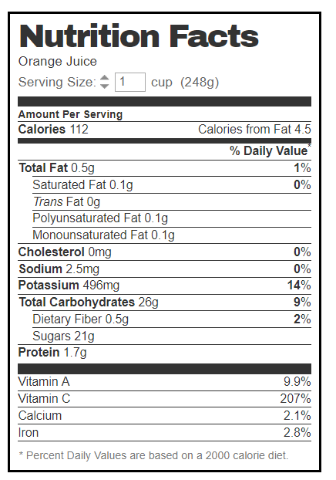
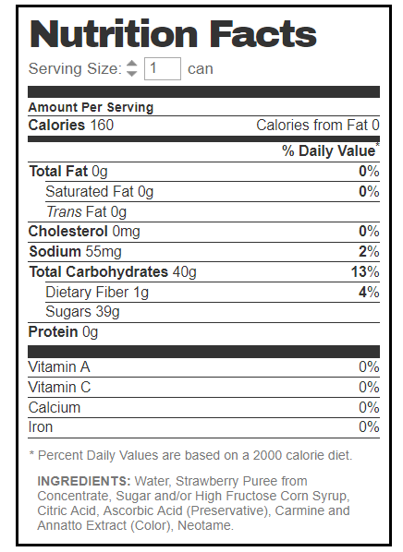
Orange Juice vs. Fruit Nectar Juice
Notes:
Remember when we were discussing Cola alternatives and I mentioned that all fruit juices are not created equal. Well, here is a great example of how regular orange juice is superior to a fruit nectar juice, which consist of about 50% fruit juice, with added sugars and water. Both of these labels are for a product that is served as a can, but the regular orange juice has only 112 calories and the fruit nectar brand drink contains 160 calories. You will notice that the regular orange juice contains almost no sodium, but is plentiful in potassium and the fruit nectar has less Potassium, but more Sodium. Remember that the WHO has reduced the amount of salt and sodium that is recommended in the diet and a healthy heart also requires more potassium. Of course both drink are made by fruits, so they will have carbohydrates, the big number to see here is that regular orange juice contains only 21 gram of carbohydrates from sugars and the fruit nectar contains 39 grams of sugars. When we think of orange juice, we always think about Vitamins. Well, here is the big separator between these two drinks. Regular orange juice is rich in Vitamins A and C and contains calcium and iron. Fruit nectar drinks on the other hand, offer none of the essential vitamins or minerals that are normally supplemented through fruits, vegetables, or juices. It is common for people to get fooled into making purchases they shouldn’t be making when they do not read the small subscripts in a contract, well, the same goes for food. The fruit nectar contains high fructose corn syrup, which is normally found in energy drinks and sodas and has been linked to obesity and many chronic conditions when used excessively. As you can tell, reading and interpreting the nutrition food label on drinks is essential for a healthy diet. Next we will go over some common meats and how they compare to one another.

Slide 11
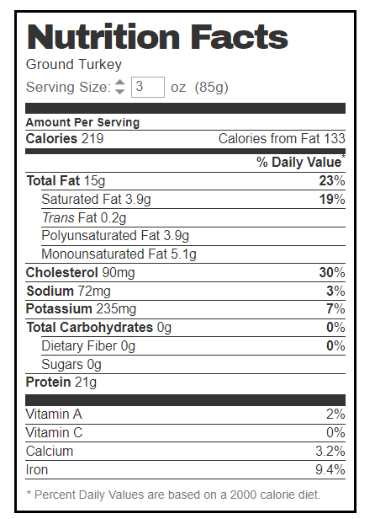
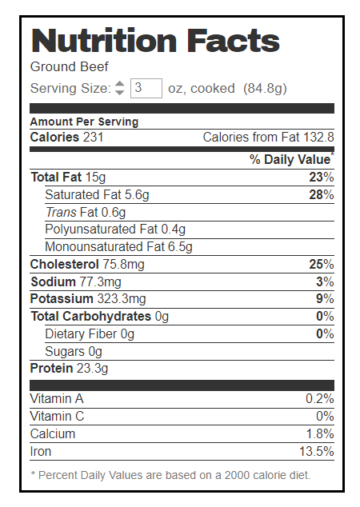
Ground Turkey vs. Ground Beef
Notes:
We already mentioned the use of the tortilla and how it is a staple food in Mexican cuisine, now let’s talk about the items that normally go inside the tortilla. In this slide we will compare the use of 3 ounces of ground turkey versus 3 ounces of ground beef. Some commonly known foods that require the use of meats in Mexican dishes are enchiladas, tacos, and burritos. When reviewing these labels, it is good to see that both are very similar in nutritional content. The ground turkey contains 219 calories per serving and is composed of 133 calories from fat. The ground beef is very close with 231 calories per serving and 132.8 calories from fat. While total fat is the same at 23 percent of the recommended daily intake, ground beef surpasses ground turkey in saturated fat by almost 10 percent. If you recall, saturated fat is one of the items that the USDA recommended limiting to under 10% of fat consumed. Everything else is pretty close in nutritional value. Cholesterol is a bit higher in ground turkey but ground beef has slightly more potassium. Both offer over 20 grams of protein and both give us an adequate amount of iron. The emphasis on this slide is that we should carefully read labels. Most people assume that turkey is healthier than ground lean beef, but that is no necessarily the case, as shown in this slide. Next we will discuss the nutritional value of two very common starches.

Slide 12
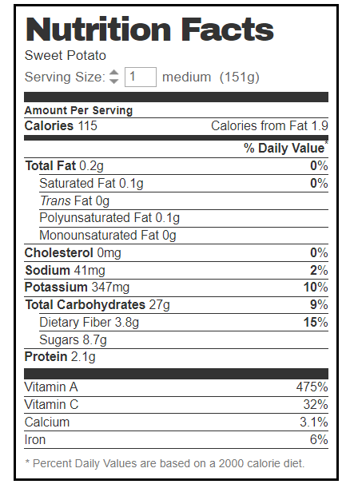
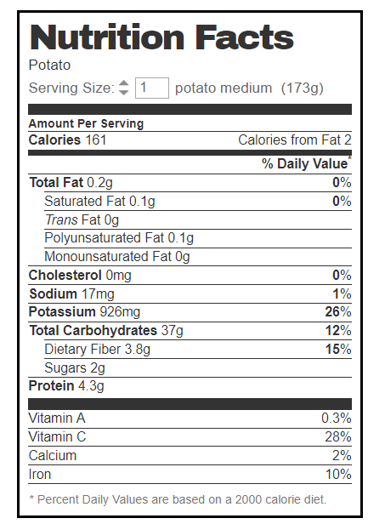
Sweet Potato Vs. White Potato
Notes:
In this final example we will compare the nutrition content in sweet potato versus white potatoes. It is safe to say that potatoes are classified as vegetables, even though they are usually seen as starchy foods. If you recall our message about vegetables, we want to use the most colorful ones if possible. In this case, sweet potatoes are a bright orange color and white potatoes are simply white. These potatoes are both medium sized potatoes but the sweet potato contains only 115 calories and the white potato contains 161 calories. They are very close to equality in their other nutrients except for potassium. White potatoes offer 26 percent of the recommended daily value and sweet potatoes offer only 10 percent. The big separator between the two is the Vitamin A content. Sweet potatoes offer 475% of the recommended daily value and white potatoes offer almost none. Vitamin A is important for normal vision, the immune system, and reproduction. Vitamin A also helps the heart, lungs, kidneys, and other organs work properly. Vitamin C, Calcium, and Iron are also rather close in each product.

Slide 13


Summary
Nutrition Facts Label
Commonly used products
Choose MyPlate model
Sodium and Salt content in foods
Notes:
In this class we taught you the importance of knowing how to read a nutrition facts label and what each section represents. We also broke down the nutritional content of certain products that we consume on a daily basis like soda, Potato Chips, Tortillas, Orange Juice, Ground meats, and potatoes. As you can see, both of the products that we compared would fall into one of the categories of the Choose MyPlate model, not all products are created equal. For example, both orange juice and the fruit nectar juice have some type of fruit content in them, but the regular orange juice is far superior in nutritional content versus the fruit nectar brand orange juice. The same goes for potatoes. While both can be placed on the vegetable portion of the Choose MyPlate model, the recommendation would be to consume sweet potatoes because of its superiority to white potatoes in Vitamin A. We discussed how salt and sodium play a role in food and we provided you with menu items representing foods with lower and higher amounts of sodium. The next class will continue to focus on the nutritional value of food. We will guide you on how to select and incorporate nutrient dense foods into your diet and by eliminating or restricting foods that are calorie dense. If you have any questions, comments, or concerns, please reach out to us by email, Messenger, or by using the comment button below. Have a great day and please use the tools that you have been provided so far when selecting healthier meals.

