Slide 1

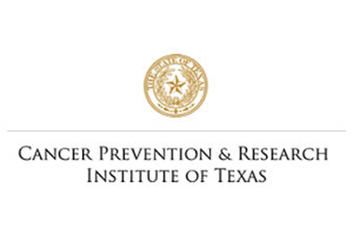


Pasos Para Prevenir Cancer:
Notes:
Good morning/afternoon my name is and I am a health educator/community health worker at Texas Tech University Health Science Center. Today we will introduce you to Pasos Para Prevenir Cancer, or PPP for short. PPP is an education and outreach program that is funded by the Cancer Prevention and Research Institute of Texas (CPRIT). The goal of PPP is to increase awareness of obesity-related cancer, while giving participants important information and tools to make nutritional and physical activity-related behavioral changes to decrease their risk of obesity-related cancers. The evidence-based educational content used in this program is consistent with messaging from organizations like the American Heart Association (AHA), the Centers for Disease Control & Prevention (CDC), the National Heart, Lung, and Blood Institute (NHLBI), and the U.S Department of Agriculture (USDA). The purpose of this presentation is to help the El Paso community make better decisions when it comes to eating meals and conducting physical activity in hopes that we can reduce the amount of obesity-related cancers in our city.

Slide 2
Overweight and Obesity Related Cancers
Notes:
Many individuals associate overweight and obesity with several chronic conditions like diabetes, hypertension, and metabolic syndrome, but now we have added cancers to the list. Excess bodyweight is associated with the development of 13 different cancer types, including breast, colorectal, brain, endometrial, esophageal, gallbladder, upper stomach, kidney, liver, multiple myeloma, ovarian, pancreatic, and thyroid cancer.

Slide 3
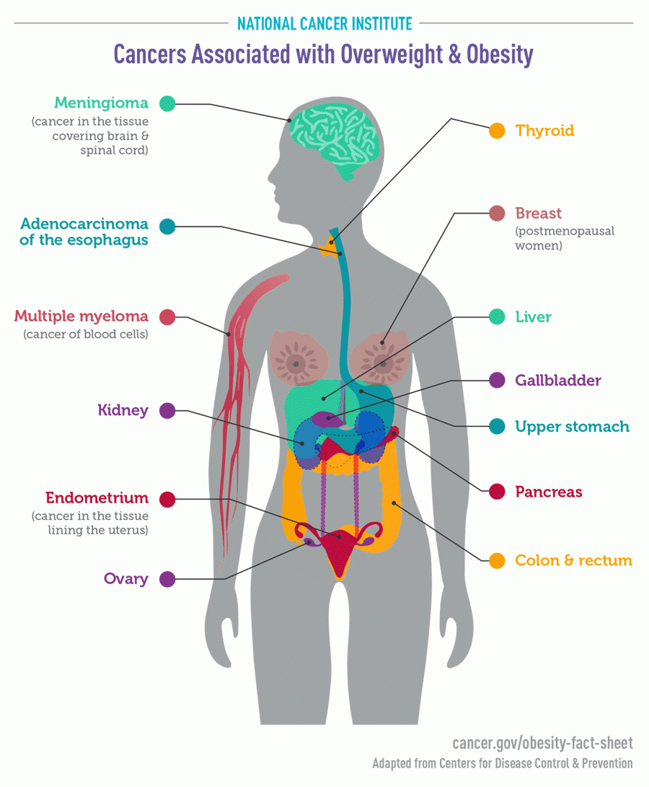
Notes:
As mentioned earlier, obesity has been labeled as a risk factor for 13 types of cancers in the body. In 2014, studies showed that roughly 630,000 people in the U.S were diagnosed with an obesity-related cancer. People who suffer from obesity are 50% more at risk to develop meningioma, twice as likely to develop adenocarcinoma of the esophagus, kidney cancer, liver cancer, and Upper stomach cancers. They are also 10-20% more at risk for multiple myeloma, 2 to 4 times more at risk for developing endometrial cancer, 1.5 times more at risk for developing pancreatic cancer and 30% more likely to develop colorectal cancer. I’m sure some of you have heard a few of these names but for those you who have not, we will go over their location and probable cause on the next slide.

Slide 4
50% more risk
Twice more risk
10-20% more risk
Twice more risk
Twice more risk
Twice more risk
1.5 times more risk
2 to 4 times more risk
30% more risk
Notes:
In this slide we are depicting a portrait of the human body and the areas that are affected by obesity-related cancers. A Meningioma is a tumor that form on the membranes covering the brain and spinal cord just inside the skull. They normally form on the three layers of membranes that are called meninges. Some symptoms of a meningioma are headaches, seizures, blurry vision, numbness, and speech problems. Adenocarcinoma is the most common type of esophageal cancer. It forms in the glandular cells of the esophagus and usually causes dysphagia, or trouble swallowing in people that have it. Thyroid cancer forms in the tissues of the thyroid gland right below the cartilage known as the Adam’s apple. Symptoms of thyroid cancer may include neck pain, voice changes, breathing difficulties, coughing or trouble swallowing. The American Cancer Society describes multiple myeloma as a cancer of plasma cells. Multiple myeloma begins when plasma cells make abnormal proteins. Some of the features of multiple myeloma are low blood counts, bone and calcium problems, infection, kidney problems, and other illnesses. The liver is the largest internal organ in the body, which is located under the right ribs just beneath the right lung. There are many forms of liver cancer, the most common form is hepatocellular carcinoma. Some cancers begin as a single tumor that grows larger while some start as many small cancer nodules throughout the liver. The gallbladder is a pear-shaped organ that is small and located on the right side of the abdomen just beneath the liver. While gallbladder cancer is uncommon, it is also very hard to find because there are no specific symptoms and the gallbladder size makes it hard to detect. Kidney cancer occurs when healthy cells in one or both kidneys grow out of control and form a tumor. Renal cell carcinoma is the most common form of kidney cancer and can spread to other parts of the body like bones, lungs, and the brain. Upper stomach, Endometrial (Uterus), Pancreatic, Breast and Ovarian cancers occur a lot like other cancers where a mutation in the cell’s DNA cause them to grow and divide at a fast rate, thus forming a tumor. We will explain this process in more detail in the upcoming slides. Colorectal cancer is the second leading cause of cancer death in women and third for men. Some signs and symptoms of colorectal cancer are iron deficiency, unexplained weight loss, fatigue, black or bloody stool, and changes in bowel habits. As stated we will go over some of these cancers in more detail in the upcoming slides.

Slide 5
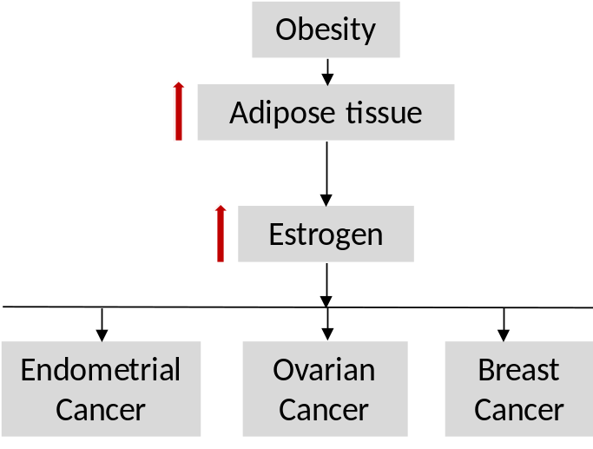
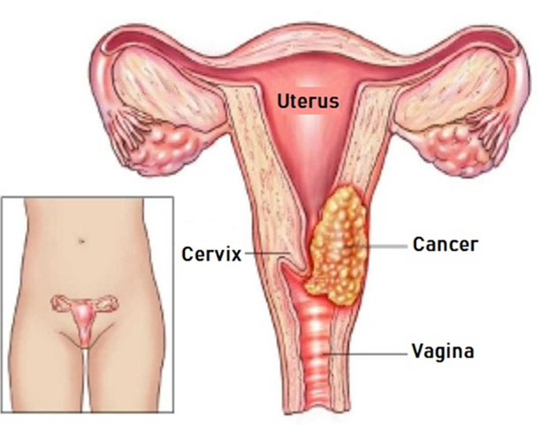
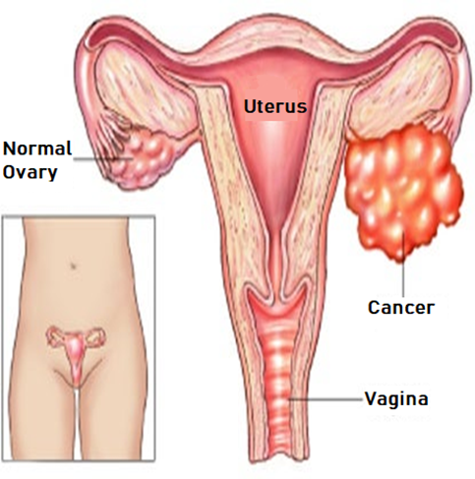
How obesity increases cancer risk?
Notes:
The next few slides will show the link between obesity and cancer. Cancer is the second leading cause of death in the United States behind heart disease. Approximately 40% to 60% of cancer patients are classified as overweight or obese. It is estimated that obesity accounts for one in seven cancer deaths for men and one in five for women. The top diagram in this slide shows the relationship between obesity, adipose tissue, estrogen and three different types of cancer that are developed in similar fashion. Adipose tissue, or fat as it is more commonly referred to, produces excess amounts of estrogen, high levels of which have been associated with increased risks of breast, endometrial, ovarian, and some other cancers. Estrogen is normally associated with females as their main sex hormone, however it is also present in males, whose main sex hormone is testosterone. The diagrams at the bottom left of the slide shows a depiction of endometrial cancer. It is easy to spot the cancer that begins in the lining of the womb. Endometrial cancer is often spotted at its early stage because it has one very obvious symptom, abnormal vaginal bleeding. The picture to the right of that shows an example of ovarian cancer. Ovarian cancer often goes undetected until it has spread within the pelvis and belly because it does not show any symptoms in the early stages, which makes it harder to detect and sometimes fatal.

Slide 6

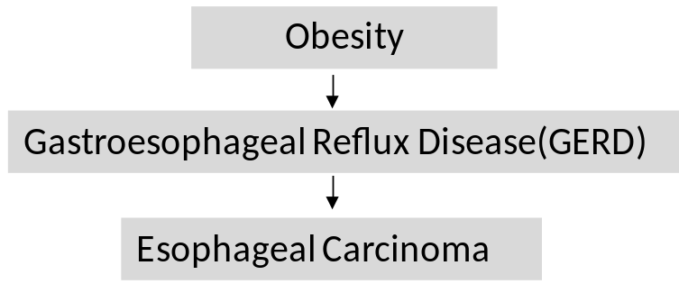
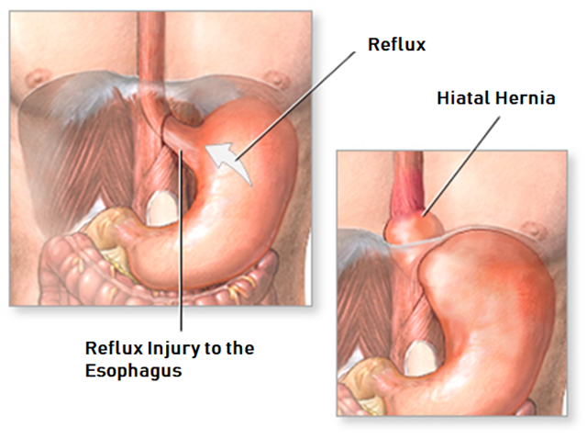
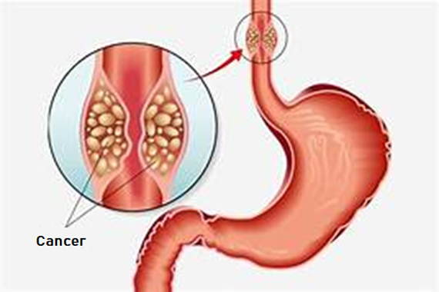
Notes:
People who are overweight or obese have a higher chance of getting adenocarcinoma of the esophagus because they are more likely to have gastroesophageal reflux, also known as GERD. This occurs when strong acids in the stomach, whose role is to help digest food, escape from the stomach up into the lower part of the esophagus. In many people, reflux causes symptoms such as heartburn or pain that seem to come from the middle of the chest, but some people experience no symptoms at all. This is a huge issue because unlike the stomach, the esophagus does not have lining that protects it from acid, thus damaging the tissue cells in the esophagus. This can lead to the eventual formation of a tumor in the esophagus. While people with GERD have a slightly higher risk in developing cancer, the risk seems to be higher in people who have more frequent symptoms. Some possible symptoms of esophageal cancer include hoarseness, chronic cough, bleeding in esophagus, and pain when swallowing food passes the tumor.

Slide 7
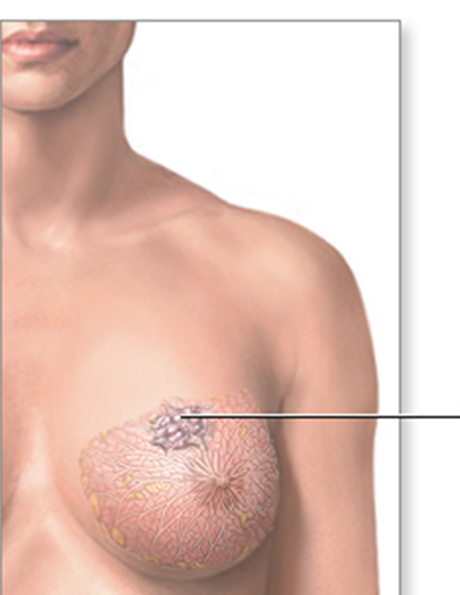
How obesity increases cancer risk?(Contd..)
Obesity
More Body Fat
More Estrogen
Breast Cancer
Breast Cancer
Notes:
As previously mentioned, breast cancer is one of the types of cancer that has been linked to obesity, especially for postmenopausal women. For example, a 5-unit increase in BMI is associated with a 12% increase in risk. In postmenopausal women, those who are obese have a 20 to 40% increased risk of developing breast cancer compared to normal weight women. This higher risk is because fat cells make estrogen; extra fat cells mean more estrogen in the body, and estrogen can make hormone-receptor-positive breast cancers develop and grow. Women who are overweight also tend to have higher levels of insulin, another hormone. Higher insulin levels have also been linked to some cancers, including breast cancer. In the next slide we will go over insulin and its effect on cancer development. We will now discuss in a little more detail how this works.

Slide 8
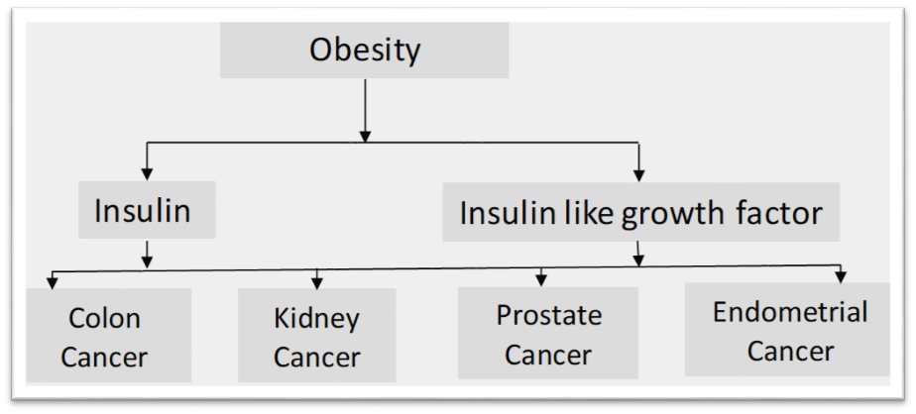
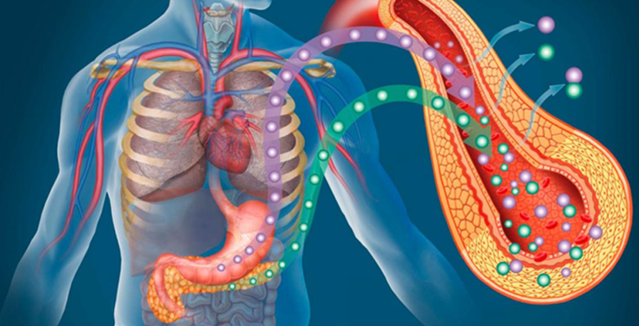
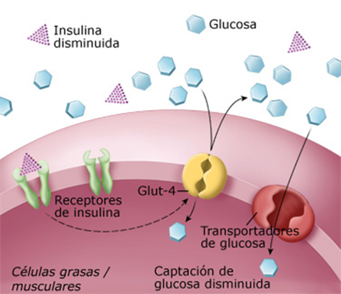
How obesity increases cancer risk?(Contd..)
Notes:
As we mentioned in the previous slide, high levels of insulin in the body have also been linked to several types of cancer. Insulin is a hormone produced in the pancreas that is necessary to help control the amount of sugar in the blood by moving blood sugar to cells for energy. Insulin resistance means that some cells in the body use insulin less effectively than normal. Consequently, the blood sugar level rises, causing insulin to rise. Obese people tend to have higher concentrations of insulin in the blood and insulin-like growth factor-1 (IGF-1). The diagram depicts a representation of how obesity, associated with increased levels of insulin and insulin-like growth factor; can lead to the development of colon, kidney, prostate, and endometrial cancers.

Slide 9
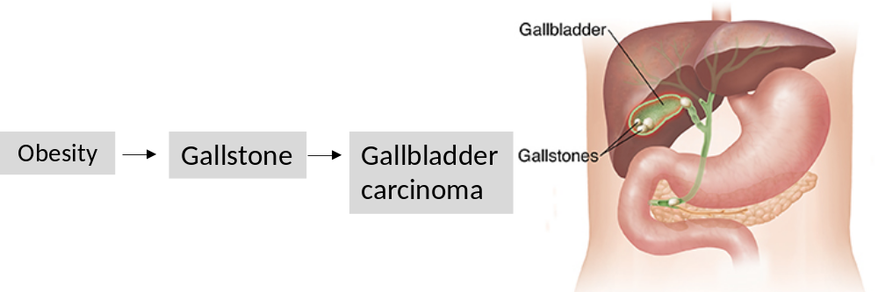
How obesity increases cancer risk?(Contd..)
Notes:
Obesity is a well-known cause of gallstone formation and gallstones increase the risk of getting diagnosed with gallbladder cancer (GBC). GBC is the most common malignancy of the biliary tract and is regarded as a highly lethal disease with an overall 5-year survival of less than 5%. Studies have indicated that three out of four people with gallbladder cancer also have gallstones and an inflamed gallbladder, which make gallstones the most common risk marker for GBC. Cancer is more likely if you have a single large stone rather than several small ones. It is believed that the large stones will irritate the gallbladder wall as they grow over time, thus increasing the risk for cancer. It is important to note that women are twice as likely to develop GBC as men in the United States. Another important thing to know is that in the U.S, Hispanics of Mexican descent and Native Americans have the highest rate of gallbladder cancer when compared to other ethnicities.

Slide 10
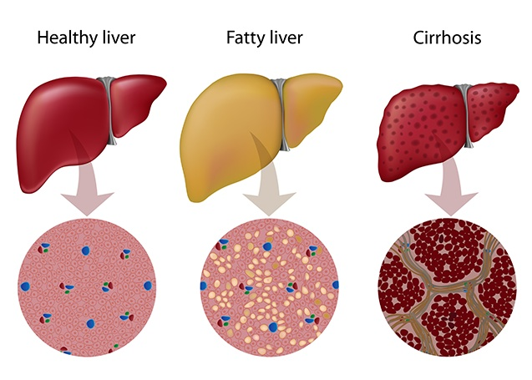
How obesity increases cancer risk?(Contd..)
Notes:
Compared to people who have a normal BMI, those who are overweight have a 21% increased risk of liver cancer and those who are obese have an 87% percent increased risk of cancer. Experts believe that fat tissue in the liver produces inflammation, which may lead to changes in liver tissue including the development of fibrosis and cirrhosis (liver damage) as well as increased risk of insulin resistance. One of the more prevalent forms of liver disease that has become a serious public health concern and is affecting our community is Nonalcoholic fatty liver disease (NAFLD). Nonalcoholic fatty liver disease is the buildup of extra fat in the liver that is not caused by alcohol and represents the leading cause of chronic liver disease for all Americans. A fatty liver is determined when 5% to 10% of the liver’s weight is fat. Nonalcoholic fatty liver disease affects almost one third of the US population and it does not discriminate for race or ethnicity. However, the Latin American population has been affected the most, with Latinos of Mexican origin having the highest prevalence (33%), followed by Latinos of Puerto Rican origin (18%), and Latinos of Dominican origin (16%). Contributing factors for Nonalcoholic fatty liver disease are being overweight, insulin resistance, Type II Diabetes, or having high cholesterol. The good thing about Nonalcoholic fatty liver disease is that unlike cirrhosis, it can be reversed, but only if cirrhosis is prevented. Prevention starts with lifestyle interventions that include caloric restriction and exercise.

Slide 11
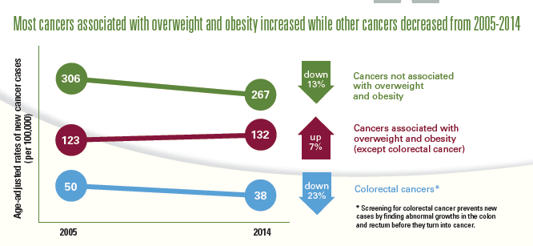
Notes:
So now that we have discussed how obesity and cancer are correlated, we can go over the nitty gritty numbers that health professionals and research scientists like to use. Studies found that between 2005 and 2014 most cancers associated with overweight and obesity increased while other cancers have decreased. This graph shows that in 2004, 306 out of 100,000 people were likely to suffer from a non-obesity related form of cancer. That number has dropped down to 267 in the same population. In the same timeframe, cancers that are associated with overweight and obesity have increased from 123 out of 100,000 to 132 out of every 100,000. There was one outlier in these studies though. Colorectal Cancer, which is an obesity related cancer, has actually dropped from 50 people to 38 people for that same population.

Slide 12


Vocabulary Review
Cancer related terms
Obesity related terms
Benign: Not Cancer
Cancer: Abnormal, uncontrolled growth of cells of any organ of the body
Estrogen: hormone that plays various roles in the body, most notably the female reproductive system
Insulin: a hormone produced in the pancreas by the islets of Langerhans, which regulates the amount of glucose in the blood
Tumor: Abnormal growth of tissue
Malignant: refers to cancer cells that can invade and kill nearby tissue and spread to other parts of your body
Metastasis: Spread of cancer from one part of the body to another
Stage: the extent of a cancer in the body
Adipose tissue: Fat tissue in the body
Aerobic physical activity: activity that increases heart rate and breathing
Body Mass Index: measure of body weight relative to height
Calorie: Unit of energy in food
Carbohydrate: major source of energy for your body. Carbs convert into glucose (sugar)
Cholesterol: fat-like substance in the body that is carried in the blood and produces hormones and vitamins
Fat: major source of energy in the diet
Hypertension: high blood pressure
Obesity: Excess body fat (BMI of 30 or higher)
Physical activity: any form of exercise or movement
Notes:
In this slide we will discuss some common words that were used in this class by Pasos Para Prevenir Cancer program and several words that are associated with cancer and obesity. If we come across a term that is not on this list and you would like to know more about it, please ask us via email, messenger, or simply comment on the link provided by facebook so that we may explain it in better detail.

Slide 13

SUMMARY
Notes:
In closing we discussed the goals of Pasos Para Prevenir Cancer and we also discussed the 13 different cancers related to overweight and obesity. We went over the process of how obesity leads to an increase in estrogen levels and then to several different forms of cancer, how obesity leads to inflammation in the form of ulcerative colitis or hepatitis and then to liver cancer. Lastly, we mentioned studies that showed a decrease in non-obesity related cancers and an increase in obesity related cancers; with the exception of colorectal cancer. On our next session will cover how we measure healthy weight and we will introduce you to body mass index (BMI) and Waist Circumference measures. I hope you all enjoyed our class and I am looking forward to our next session. If you have any question or comments you would like to be addressed about this class, feel free to contact us via email or simply send us a Facebook message or comment.

